Slide 1






MY MESS
Thanks
My mess
problem
cause
problem
introduction
-JAYANT KUMAR
-RISHU RAJ
-RAUNAK KUMAR

Slide 2

NEED OF
FOOD MANAGEMENT
Food is one of the most fundamental necessities for every being. life is not feasible without Food nourishment. Food wastage prevails an alarming problem. Our lanes, boulevard, streets and garbage bins, landfills have sufficient evidence to prove it. In one of the many reasons, one includes our mess too.A large amount of food is being wasted in our mess. There are many justified reasons for it. Suppose a student who has decided not to have lunch, dinner and other meals for any reason. But the mess authority hasn't been informed. The food prepared for him/her goes on untouched and being wasted. If there are 10 such amateurs doing the same deed. We can comprehend the portion of good quality food being ruined. This food, at last, is thrown into an open pit resulting in a waste of valuable sustenance. This comes about due to the lack of communication media between students and the mess authority.
Thanks
My mess
problem
Detail
problem
introduction

Slide 3
We want to create an Application that binds students with the mess authorities, where they could communicate and convey. A student who is skipping any of the meals can easily notify the concerned authorities about it, in advance, leading to less consumption of raw materials required for the preparation of the meals. The day at which veg and non-veg food are being served, every student will get notified for the voting for the veg or the non-veg, steering Mess to get the most precise data about the number of students willing to have veg and non-veg food respectively. If somehow some food will be left,Then leftover food will be supplied to the needy people by NGO.
Thanks
problem
My mess
problem
Detail
introduction

Slide 4
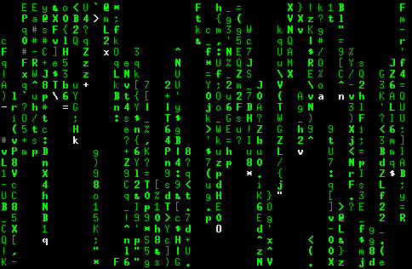





Login portal
Thanks
problem
My mess
problem
introduction
Detail
The communication between student and mess authority will be stablished.
The communication between mess authority and ngo will be stablished.
STUDENT PORTAL
MESS
PORTAL
NGO
PORTAL

Slide 5

Thanks
problem
My mess
problem
introduction
Detail

Slide 6
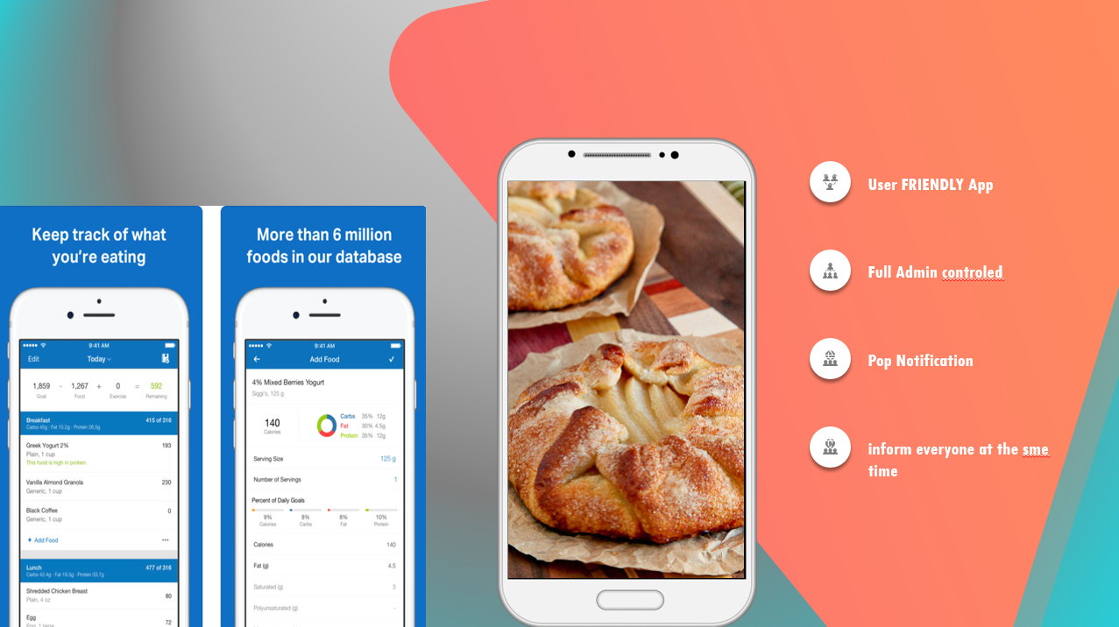
solution
problem
My mess
problem
introduction
Detail

Slide 7

Thanks
problem
My mess
problem
introduction
Detail

Slide 8

Thanks
problem
My mess
problem
introduction
Detail

Slide 9
Thanks
problem
My mess
problem
introduction
Detail
75% referendum
65%
90%
Referendum
Increase in employment
Cost effective
Increase in employment
Cost effective

Slide 10

Thanks
problem
My mess
introduction
Detail

